Slide 1
calculator
a calculator doing a mathematical operation as
adding
subtraction-
multiplying
float number

Slide 2
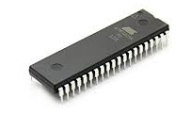
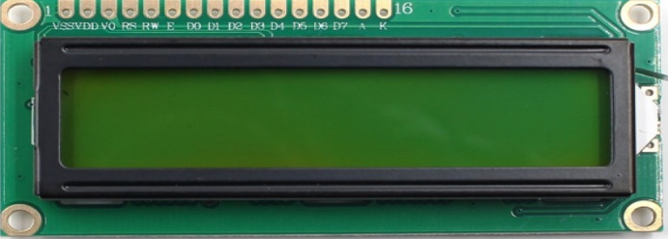
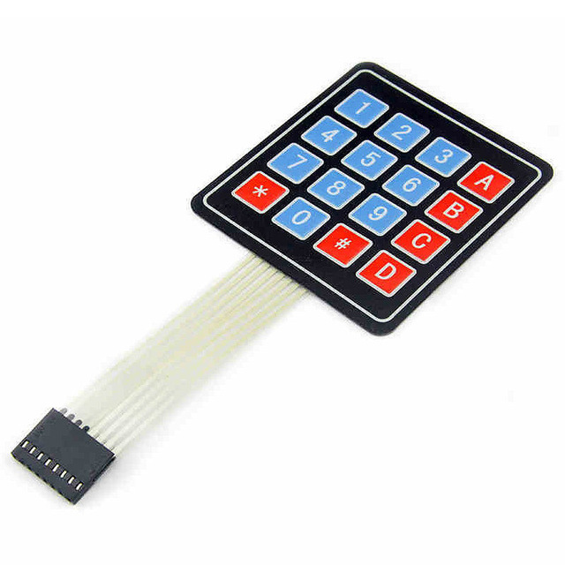
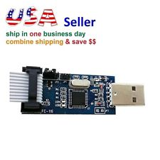
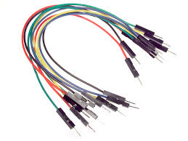
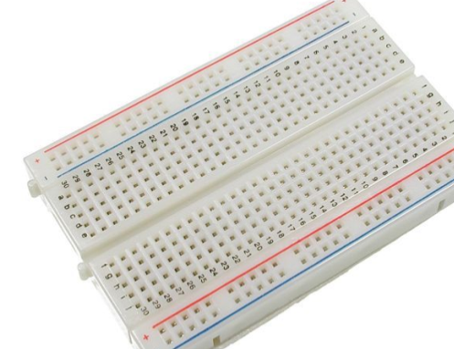
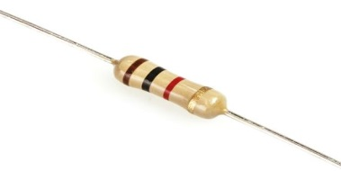
Component used :-
Atmega16A
lcd 16x2-
keypad4x4-
USB Avr programmer –
jumbers-
bread board
Resistor

Slide 3
Scan keypad

Slide 4
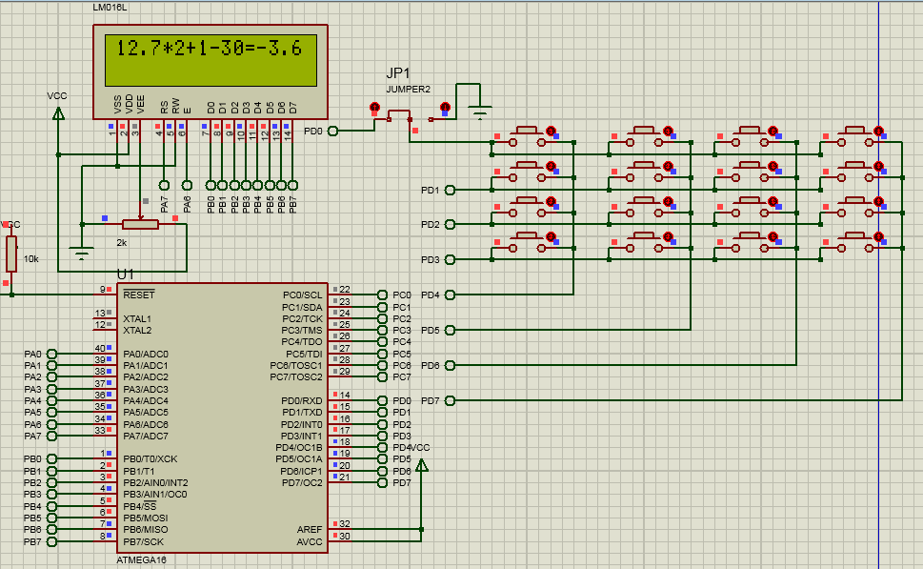
SIMULATION

Slide 5
12.7X2+1-30=-3.6
While(X)
Mathematical operations
symbols
numbers
While(y!=13)
While
(Num[i]!=13)
y=Keypad_Scan(); Num[i]=y-48;
if (Num[i]==('C'-48))

Slide 6
12.7X2+1-30=-3.6
numbers
symbols

Slide 7
12.7X2+1-30=-3.6
While(X)
Mathematical operations
symbols
numbers
While(y!=13)
While
(Num[i]!=13)
y=Keypad_Scan(); Num[i]=y-48;
if (Num[i]==('C'-48))

Slide 8
12.7X2+1-30=-3.6
Mathematical operations

Slide 9
Example:(-3.6)
Num
Polar
Integer
POINT
Float
(H_Num)
(L_Num)

Slide 10
Num
Lcd_data_write(‘0’)
Nom==0
Num!=0
{N[i]=45;
i++;}
If (Num<0)
{Num*=-1
polar=1}
H_Num=(int)num
H_Num!=0
N[i]=(H_Num%10)+48;
H_Num/=10;
i++;
{if (L_Num>0){
i--;
while(i>=0)
lcd_data_write(N[i]);
i--;}}
if (polar==1)
while(L<=4)
{ L_Num*=10; N_L[L+5]=48; N_L[L]=((int)L_Num)+48; L_Num=L_Num-N_L[L]+48; L++; }
for (L--;L>=0;L--)
if(N_L[L]!=48||N_L[L+1]!=48||N_L[L+2]!=48||N_L[L+3]!=48||N_L[L+4]!=48)
{ N[i]=N_L[L]; i++; }
} N[i]=46;
i++; }
=-3.6

Slide 11
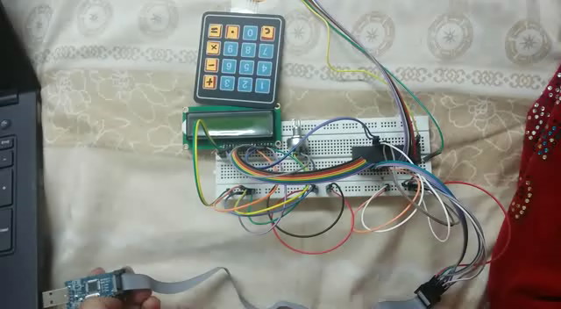
VEDIO

